Slide 1
Time-Series Pattern Recognition Algorithm Development
Pattern Recognition MVP Project

Slide 2
Problem statement and Approaches
Problem statement
Given a group of template time-series T_{k} , k=1,..,K where each time-series is of dimension T_{k} ϵ R ^{Nv x Ntk} (N_{tk} = number of time samples in pattern k; N_{v} = number of variables), and a historical time-series H ϵ R ^{Nv x Nh} (N_{tk} = number of time samples in pattern) we want to identify time series sub-sequences in H that are similar to each of the templates T_{k} .

Slide 3
Problem statement and Approaches
Potential approaches
Time-Series Subsequence matching
For a given template T_{k} , a number of subsequences in H are identified to be similar to using certain similarity metric in the original domain or a transformed domain.
Classification/ Clustering
Given a number of examples of each one of the template patterns T_{k} , a classifier is created. The classifier can be used to determine the class membership of different subsequences in the historical data.

Slide 4
Development Strategy
Algorithm development will be completed in a series of smaller development effort, each of them focused on the development and testing of particular algorithmic elements
Prototype 1:
Objectives:
Provide an initial test bed to analyze the TSA pattern identification case study
Test the sliding window approach to the subsequence matching problem
Test the Dynamic Time Warping approach (implemented in the MLPY library) as a similarity metric between time series.

Slide 5
Development Strategy
Algorithm development will be completed in a series of smaller development effort, each of them focused on the development and testing of particular algorithmic elements
Prototype 2:
Objectives:
Test different time series representation (dimensionality reduction) approaches that allow “lower bounding” with specific distance measurement
The tests will be oriented towards assessing the impact that data indexing (using lower bounding) can have on the computational efficiency of the match search algorithm.
The selection of a promising time series representation is in progress.

Slide 6
Development Strategy
Algorithm development will be completed in a series of smaller development effort, each of them focused on the development and testing of particular algorithmic elements
Prototype 2:
Objectives:
Test different time series representation (dimensionality reduction) approaches that allow “lower bounding” with specific distance measurement
The tests will be oriented towards assessing the impact that data indexing (using lower bounding) can have on the computational efficiency of the match search algorithm.
The selection of a promising time series representation is in progress.

Slide 7
Development Strategy
Algorithm development will be completed in a series of smaller development effort, each of them focused on the development and testing of particular algorithmic elements
Prototype 3:
Objectives:
Test different a couple of different classification approaches
Kernel SVM
Kernel Proximal SVM

Slide 8
Development
Prototype 1: LTW assignment
S1 sequence
S2 sequence

Slide 9
Development
Prototype 1: DTW assignment
S1 sequence
ws
ws
S2 sequence

Slide 10
Development
Prototype 1: DTW assignment
Feasible assignments
S1 sequence
S2 sequence

Slide 11
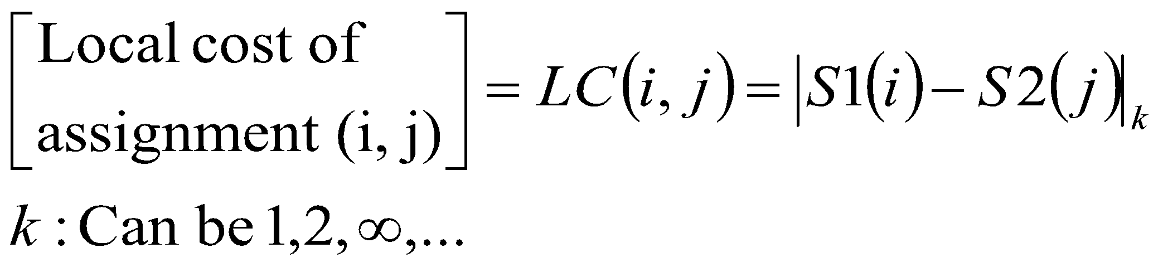
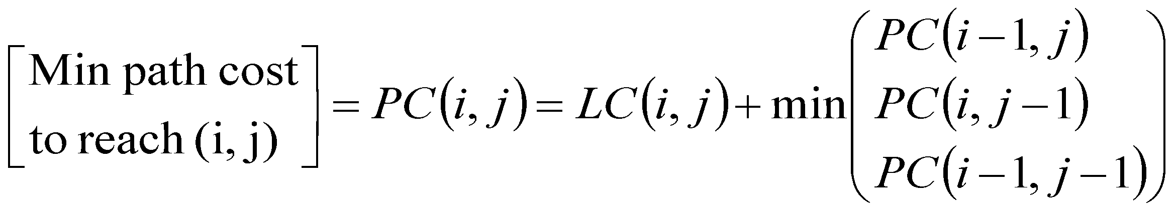
Development
Prototype 1: DTW assignment
Path cost calculation
S1 sequence
S2 sequence

Slide 12
Development
Prototype 1: DTW assignment
Feasible assignments
Forward steps for min path cost
S1 sequence
S2 sequence

Slide 13
Development
Prototype 1: DTW assignment
Feasible assignments
Trace back of min cost path
S1 sequence
S2 sequence

Slide 14
Development
Prototype 1: DTW assignment
Trace back of min cost path
S1 sequence
S2 sequence

Slide 15
Development
Prototype 1: DTW assignment
Optimal assignment set
S1 sequence
S2 sequence

Slide 16
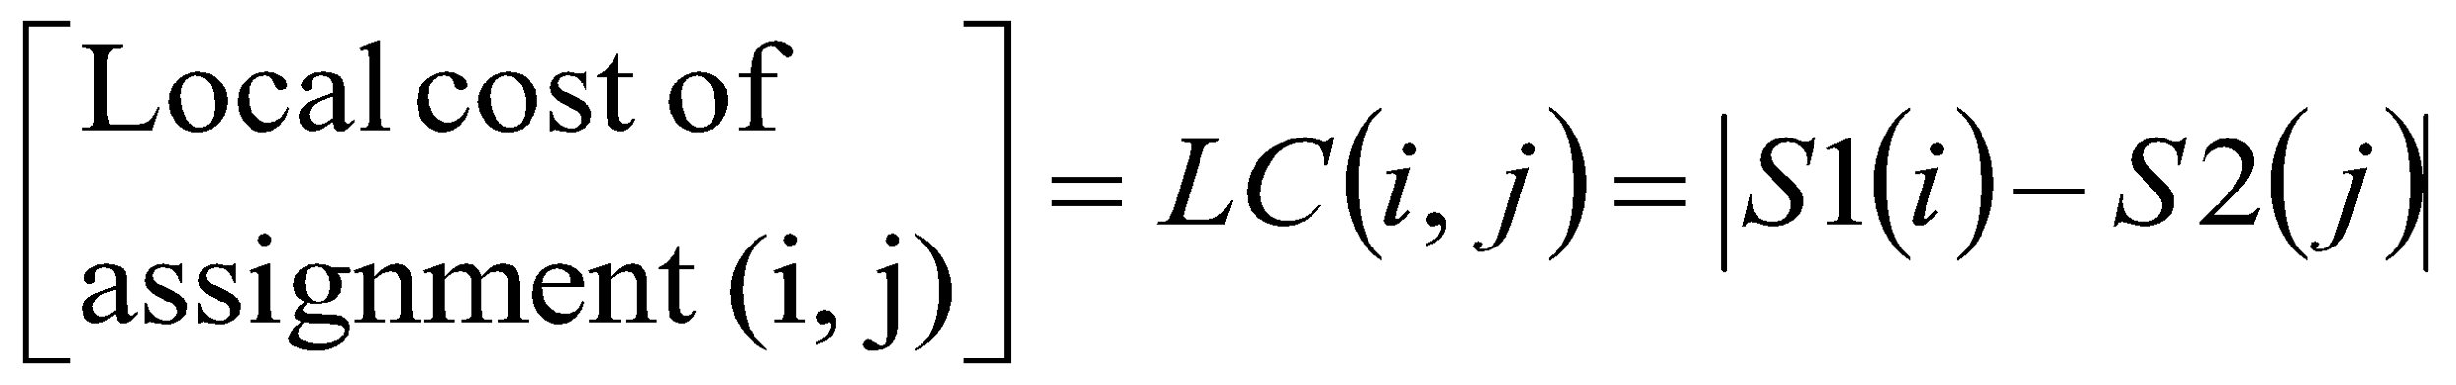
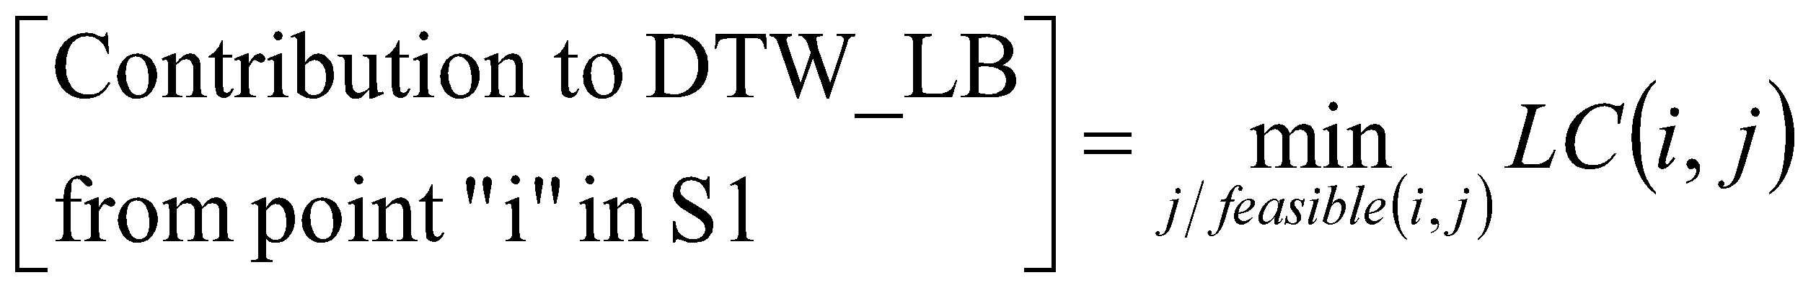
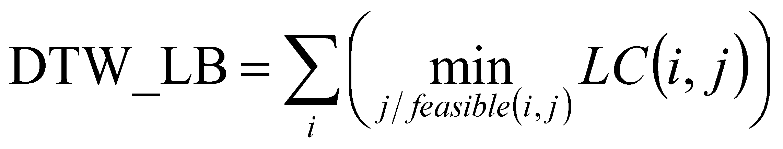
Development
Feasible assignments
Prototype 1: DTW Lower Bound
Feasible assignments for each S1 point
Assignments with min local cost in each row
S1 sequence
S2 sequence

Slide 17
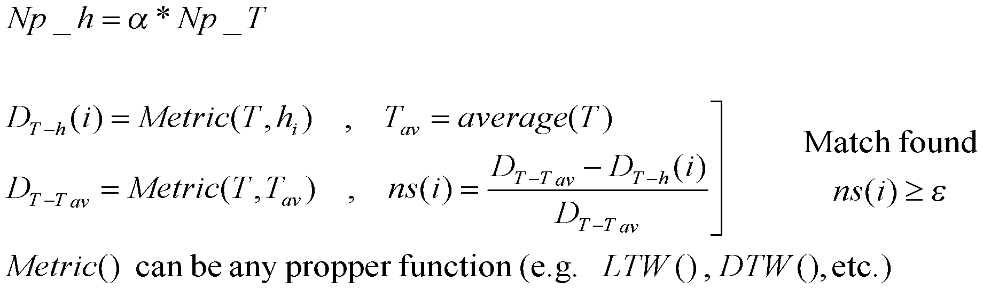
Development
Prototype 1:
h_{i}
h_{i}
H ϵ R^{NvxNp_H}
h_{i}
h_{i}
h_{i}
h_{i}
h_{i}
h_{i}
h_{i}
h_{i}
h_{i}
h_{i}
Sliding Windows
h_{i}
h_{i}
h_{i}
h_{i}
h_{i}
h_{i}
h_{i}
h_{i}
h_{i}
^{Np_h}
T ϵ R^{NvxNp_T}
^{Np_T}

Slide 18
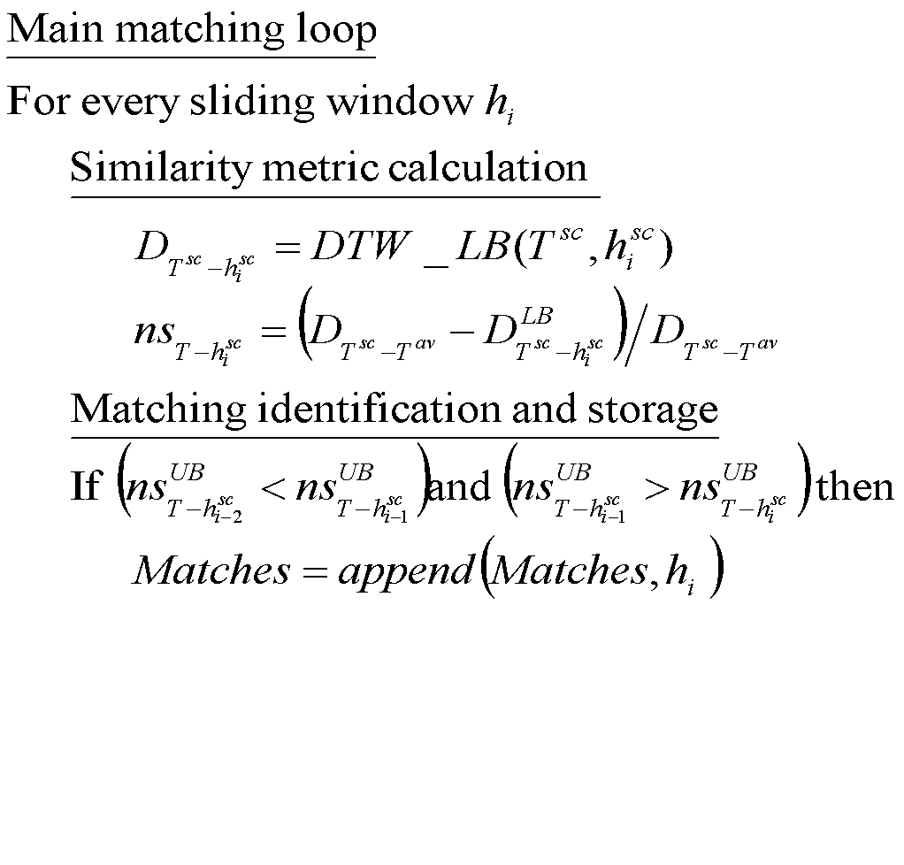
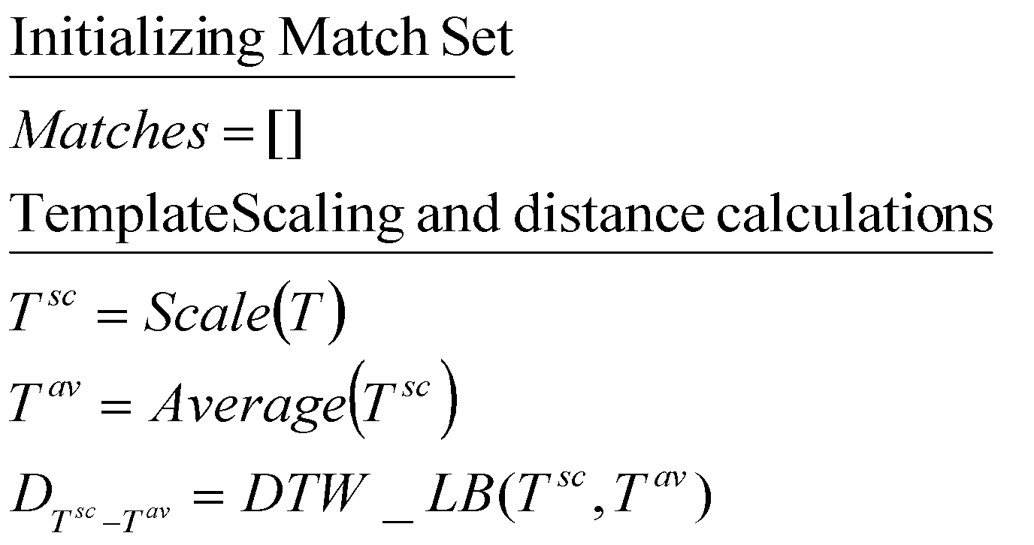
Development
Prototype 1: Original sub-sequence matching algorithm

Slide 19
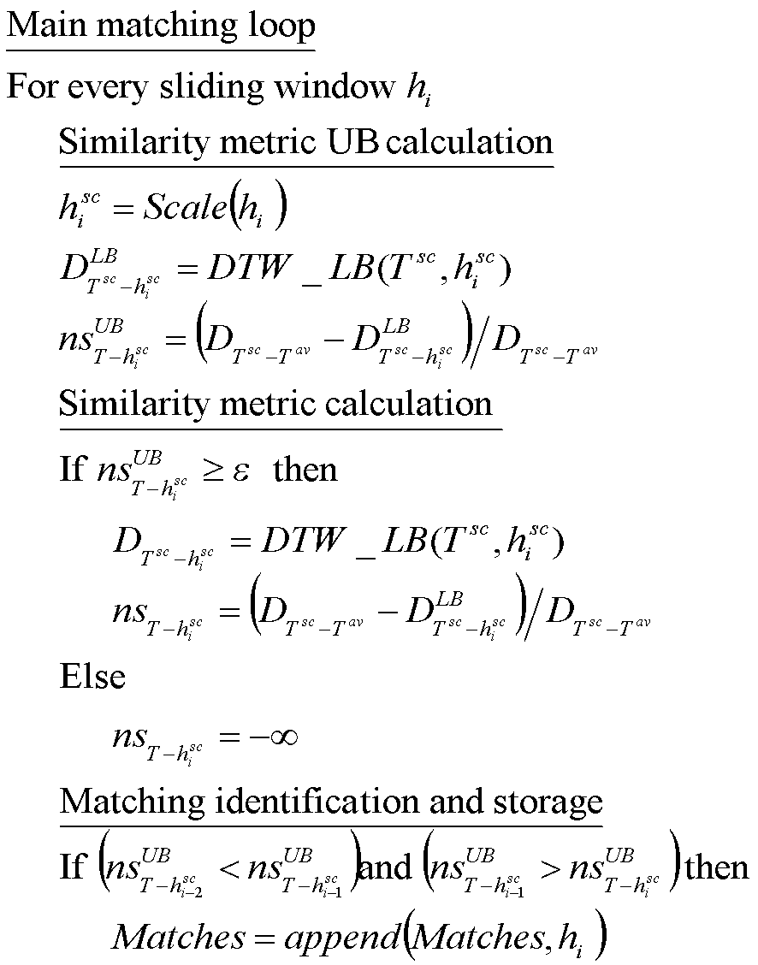
Development
Prototype 1: Sub-sequence matching algorithm with DTW lower bounding

Slide 20
Development
Prototype 1: DTW Lower Bound Use

Slide 21
Results
Different runs completed
Data set
TSA data set
Template size : 397x3
Historical data size: 14401x3
SSSM algorithm
Epsilon: 0.5
Alpha: 1.0
Norm: L2sq
(Base case) SSM algorithm in Python using our Python implementation of DTW and no Lower Bounding :
Process Time for TSA data set = 6.5 hrs
(Atl case 1) SSM algorithm in Python using our Python implementation of DTW and Lower Bounding:
Speed = 62x (Base case)
(Atl case 2) SSM algorithm in R using DTW library in R and no Lower Bounding :
Speed = 79x (Base case)

Slide 22
Next steps
Following 2 weeks
Continue visualization infrastructure implementation
Implementation of dimensionality reduction/similarity metric combo

Slide 23
Questions

